Slide 1
Sudoku Solver Visualizer
Bali Mohan Rao​

Slide 2


Project Introduction
A
This Project is about to solving a Sudoku Problem by a particular method which gives a correct solution for given problem.

Slide 3
What is Sudoku ?
Sudoku is a popular logic-based number placement puzzle. The objective is to fill a 9x9 grid with digits from 1 to 9, so that each column, each row, and each of the nine 3x3 subgrids that compose the grid contain all of the digits from 1 to 9.
.

Slide 4
Backtracking Algorithm to Solve Sudoku
1.Find an Empty Cell:
2.Try a Number:
3.Check Validity:
Search the grid to find an empty cell
(a cell with a value of 0 or a placeholder like '_').
Try placing each number from 1 to 9 in the empty cell.
Check if placing the number in the cell is valid according to Sudoku rules (i.e., the number does not already exist in the current row, column, or 3x3 subgrid).

Slide 5
Backtracking Algorithm to Solve Sudoku
4.Recursive Step:
5.Backtrack:
6.Repeat:
If the number is valid, place it in the cell and recursively attempt to fill in the next empty cell using the same steps.
If the grid is successfully filled, the puzzle is solved.
If placing the number leads to a dead end, backtrack by removing the number
If all numbers from 1 to 9 have been tried and none lead to a solution, backtrack to the previous cell and try a different number there.
Repeat the process until the grid is completely and correctly filled.

Slide 6
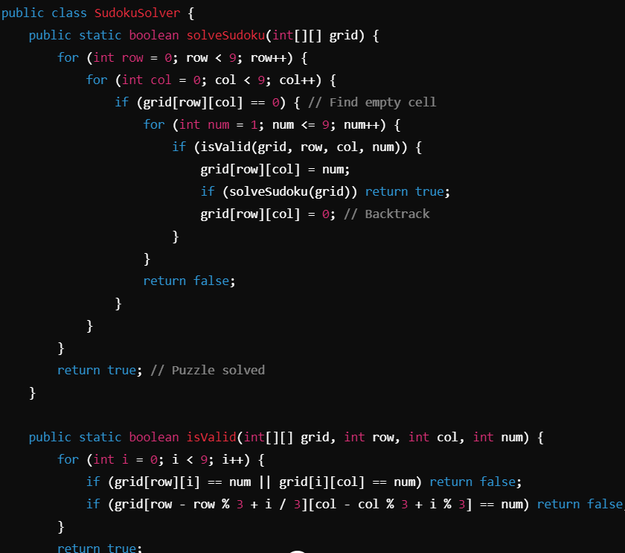
Pseudocode
F
.
.

Slide 7
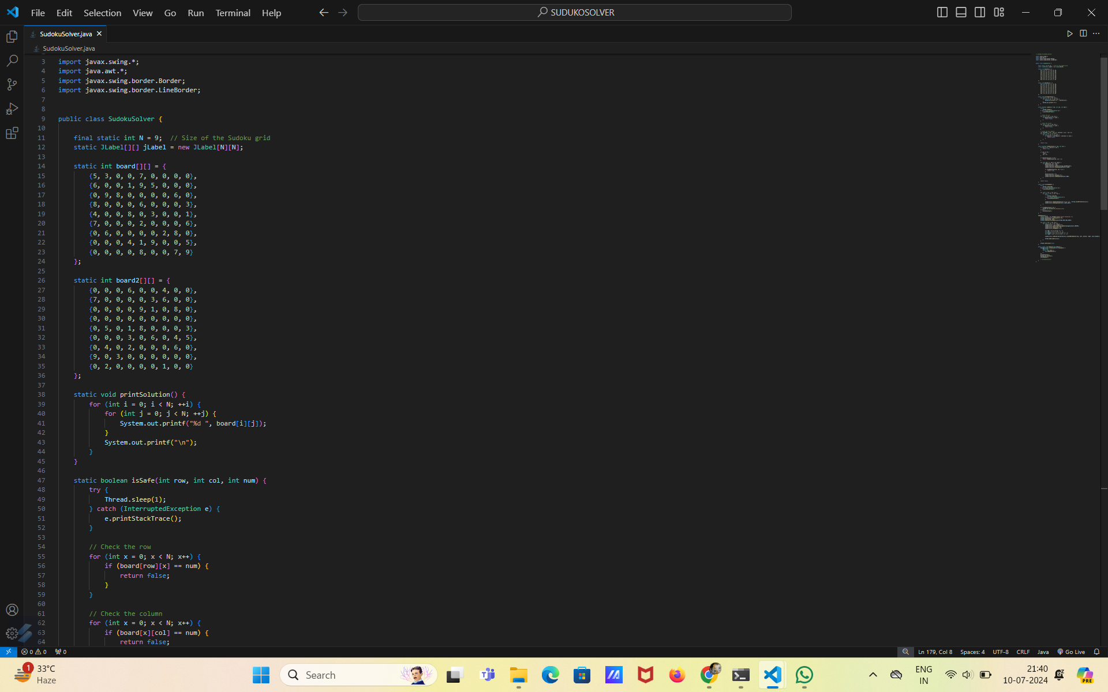
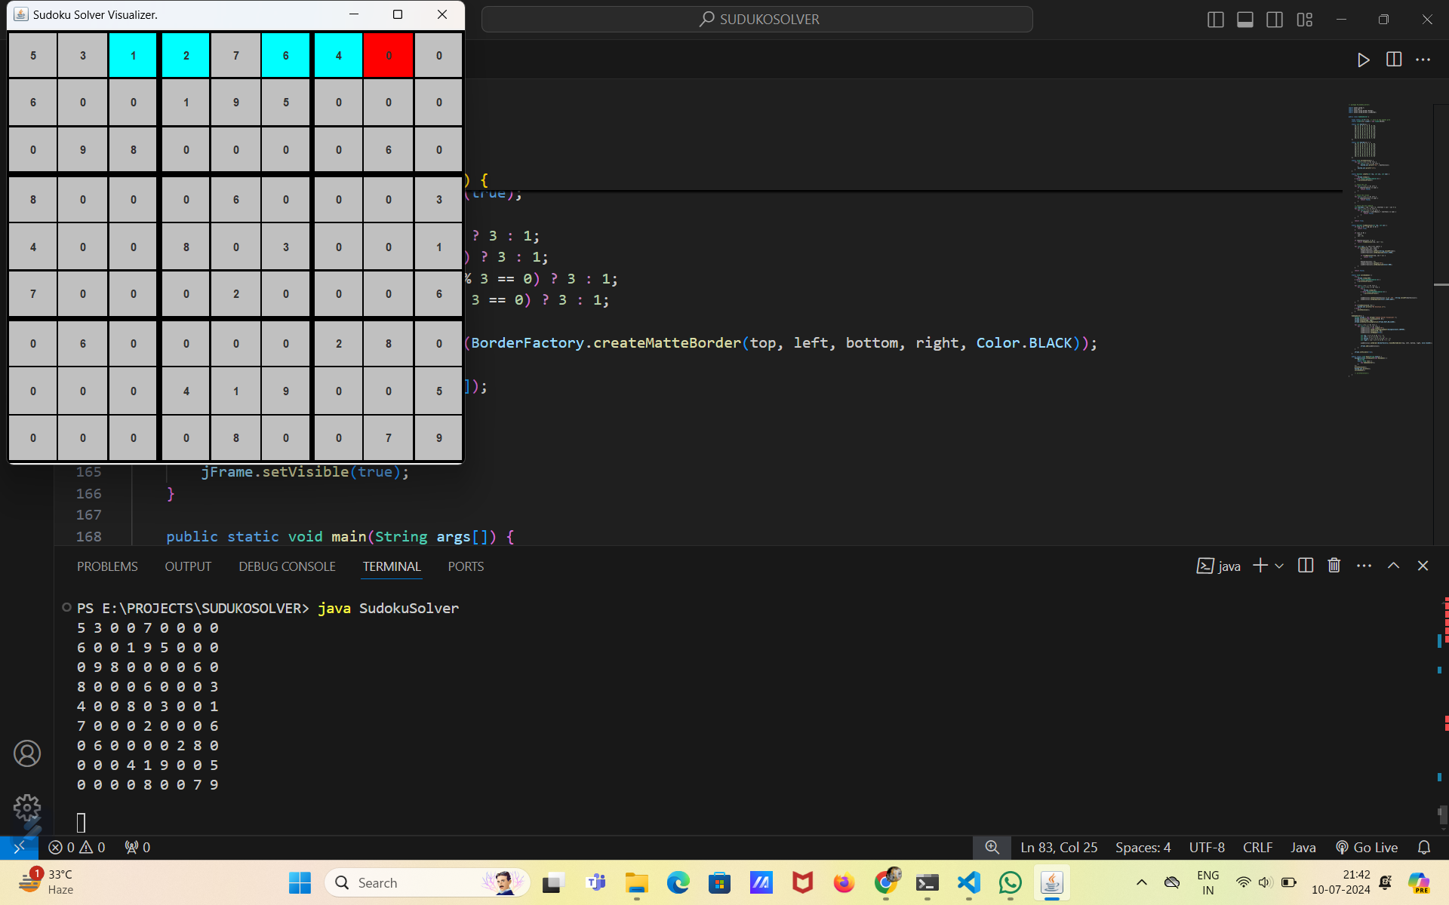

Slide 8
Thank you
Bali Mohan Rao
12216088

